Slide 1
Ulinkers
Final Presentation
Teh Kaixin
Nicole Goh
Sean Kwok
Nabilah Banu
Chien Shu Yan

Slide 2
Agenda
Introduction
Problem & Solution
Technologies
User Testing
Project Management
X-Factor
Reflections

Slide 3








Nicole Goh
Teh Kaixin
Lead Frontend Developer
Deputy Project Manager
Project Manager
Deputy Quality Assurance
Nabilah Banu
Business Analyst
Deputy Frontend Developer
Sean Kwok
Chien Shu Yan
Lead Backend Developer
Lead Quality Assurance
Professor Steven Hoi
Linda Siow
Supervisor
Sponsor
Introduction
Problem and Solution
Technologies
User Testing
Project Management
X-Factor
Reflections

Slide 4



Operating since 1996
Our Sponsor
Medical concierge provider:
Clinic & hospitalisation arrangements
Treatment plans & price estimates
Travel arrangements & visas
Standby assistance in Singapore
Ulink Assist Pte Ltd
Clients:
Indonesia, Malaysia, Cambodia, Vietnam, Myanmar & China
15 Employees

Slide 5
Problem
No platform for Ulink to recommend screenings to client
Difficult to determine engagements with stakeholders
Unable to keep track of teams’ performances
Introduction
Problem and Solution
Technologies
User Testing
Project Management
X-Factor
Reflections
Notes:
currently customers come to find ulink for screenings and there is no platform for ulink to push screenings to customers.

Slide 6
Problem
Majority of clients visit Ulink for one-off services
Ulink wishes to be more active in maintaining customer relationships
Zoho lacks functionality to recommend screenings based on clients’ demographics
No platform for Ulink to recommend screenings to client
Introduction
Problem and Solution
Technologies
User Testing
Project Management
X-Factor
Reflections
Notes:
currently customers come to find ulink for screenings and there is no platform for ulink to push screenings to customers.
Instead of waiting for the clients to approach them

Slide 7
Problem
Difficult to prioritize stakeholders – Eg. Doctors, Referrals
Difficult to determine engagements with stakeholders
Introduction
Problem and Solution
Technologies
User Testing
Project Management
X-Factor
Reflections
Notes:
currently customers come to find ulink for screenings and there is no platform for ulink to push screenings to customers.

Slide 8
Problem
2 Main teams: Medical and Visa
Zoho CRM lacks the feature to provide cross-team performance comparisons
No proper record of teams’ performances
Unable to efficiently allocate resources
Lack of basic information of clients
Importance of contact information for active engagement
Unable to maximize marketing effort
Unable to keep track of teams’ performances
Introduction
Problem and Solution
Technologies
User Testing
Project Management
X-Factor
Reflections
Notes:
currently customers come to find ulink for screenings and there is no platform for ulink to push screenings to customers.

Slide 9
Ulink Reporting System
1
Reporting tools for decision making
2
Screenings recommendation and reminder
3
Dashboard displays statistics and overview
4
Client’s Profile
Introduction
Problem and Solution
Technologies
User Testing
Project Management
X-Factor
Reflections

Slide 10
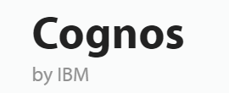


Research
Pros: | Intuitive Reports Flexible deployment | Wide range of data visualization
Cons: | Most functions not required Difficult to manage More appropriate for huge organisation Sharing of insights can be complicated | Can be cost prohibitive Still need IT expertise for data preparation No functionality for scheduling or notification of reports
Introduction
Problem and Solution
Technologies
User Testing
Project Management
X-Factor
Reflections

Slide 11



Comparison
Recommended screening based on demographic
Dashboard Reporting (Key performance metrics)
Monitor Departments’ Performance
Ranking (Stakeholder engagements)
Client Profile (Consolidated profile view of each client)
Email function
Generate Reports
Introduction
Problem and Solution
Technologies
User Testing
Project Management
X-Factor
Reflections

Slide 12
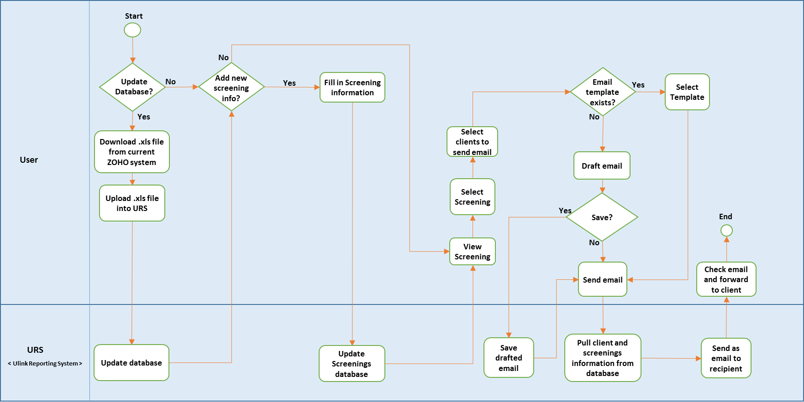
To-Be Workflow (Screenings and Email)
Introduction
Problem and Solution
Technologies
User Testing
Project Management
X-Factor
Reflections

Slide 13
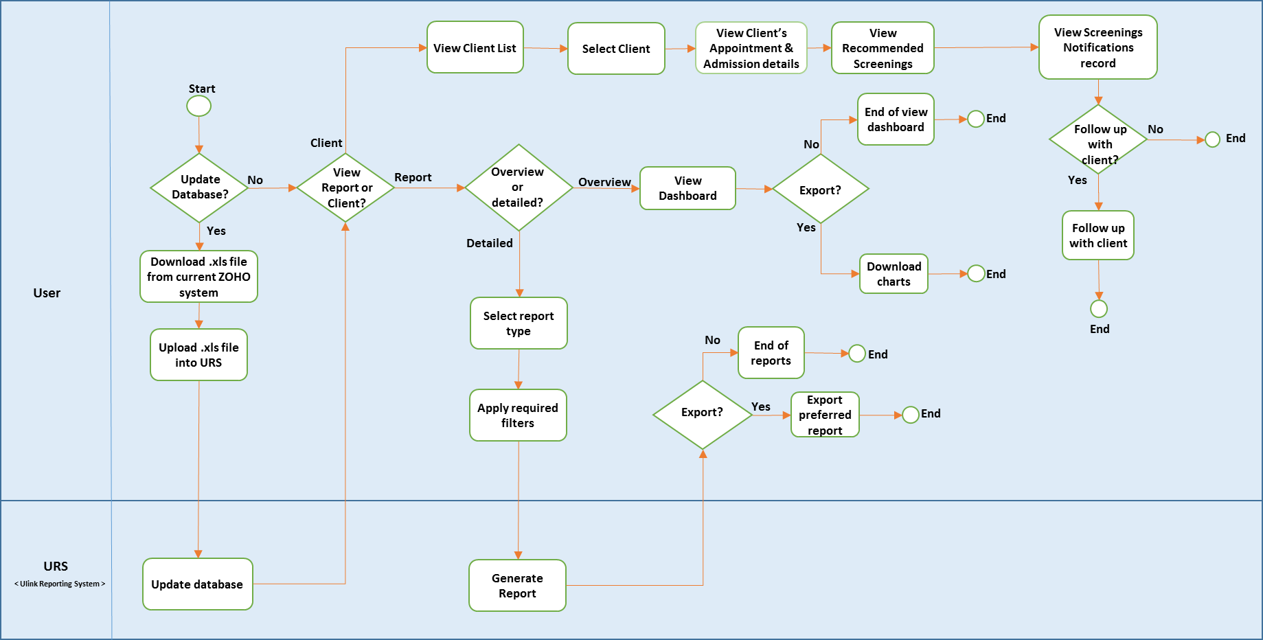
To-Be Workflow (Client, Dashboard and Reports)
Introduction
Problem and Solution
Technologies
User Testing
Project Management
X-Factor
Reflections

Slide 14

DEMONSTRATION
Introduction
Problem and Solution
Technologies
User Testing
Project Management
X-Factor
Reflections

Slide 15

Technology
Architecture Diagram
Technical Complexity

Slide 16












Architecture Diagram
FRONTEND
BACKEND
OTHER SERVICES
HTTP GET POST JSON
JSON OUTPUT
Introduction
Problem and Solution
Technologies
User Testing
Project Management
X-Factor
Reflections

Slide 17
TECHNICAL COMPLEXITY
Introduction
Problem and Solution
Technologies
User Testing
Project Management
X-Factor
Reflections

Slide 18
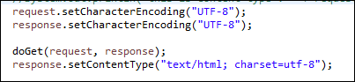
Technical Complexity
Encoding Character
Problems:
Default Encoding value for getParameter - ISO-8859-1
Unable to read UTF-8 encoding value
Solution:
Change database storing format and encoding value for getParameter
Introduction
Problem and Solution
Technologies
User Testing
Project Management
X-Factor
Reflections

Slide 19
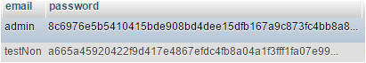
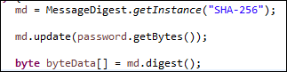
Technical Complexity
Security
Problems:
To prevent client information being compromised
Solution:
Encrypt password using SHA-256
Introduction
Problem and Solution
Technologies
User Testing
Project Management
X-Factor
Reflections

Slide 20
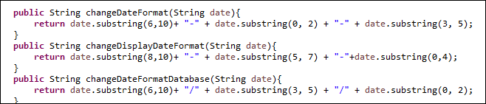
Technical Complexity
Different Date Formats
Problems:
Many different types of date format required
Solution:
Joda Time library & calendar from Java
Introduction
Problem and Solution
Technologies
User Testing
Project Management
X-Factor
Reflections

Slide 21
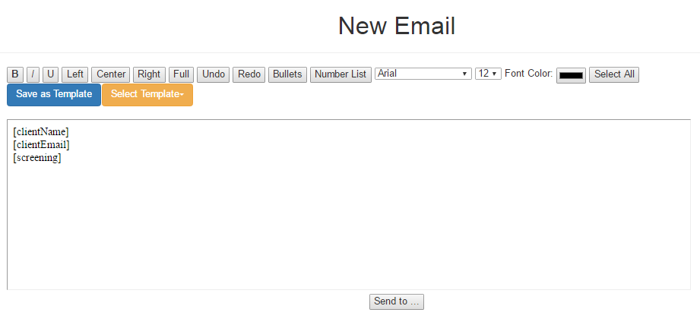
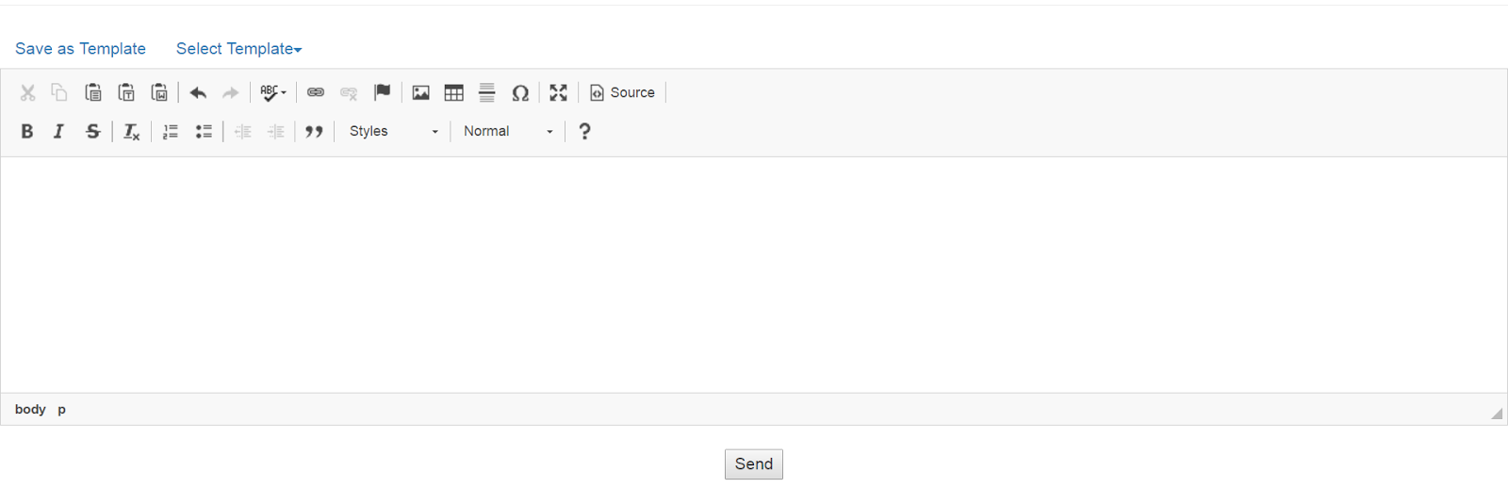
Technical Complexity
Text Editor (iFrame)
Problems:
Edit mode not user-friendly
Cannot save pasted text directly
Looks “Raw”
Solution:
Before
After
Introduction
Problem and Solution
Technologies
User Testing
Project Management
X-Factor
Reflections

Slide 22
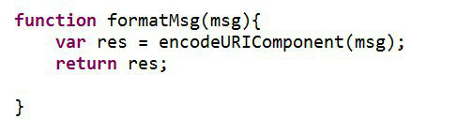
Technical Complexity
Saving Email template in HTML format
Problem:
Need to replace symbols to preserve original format
Solution:
EncodeURIComponent
Introduction
Problem and Solution
Technologies
User Testing
Project Management
X-Factor
Reflections

Slide 23
Technical Complexity
Problem:
SEAN – zoho database
Solution:
Introduction
Problem and Solution
Technologies
User Testing
Project Management
X-Factor
Reflections

Slide 24

Quality Assurance
User Testing
Internal Testing

Slide 25


User Testing 1
Purpose: Gather UI feedback & detect usability issues
Participant: Linda (Sponsor)
Date: 28 October 2016
Time: 4.00pm
Venue: Ulink Assist Pte Ltd
Scope:
Client Creation Module
Timeline Module
Reports Module
KPI
Ranking
Gender - Age Report
Easy to navigate
Timeline for screenings design is not intuitive
Naming of columns and fields are confusing
Introduction
Problem and Solution
Technologies
User Testing
Project Management
X-Factor
Reflections
Notes:
Client prefers to choose which patient to send email to instead of automated sending of email
Analysis results to be in numbers

Slide 26
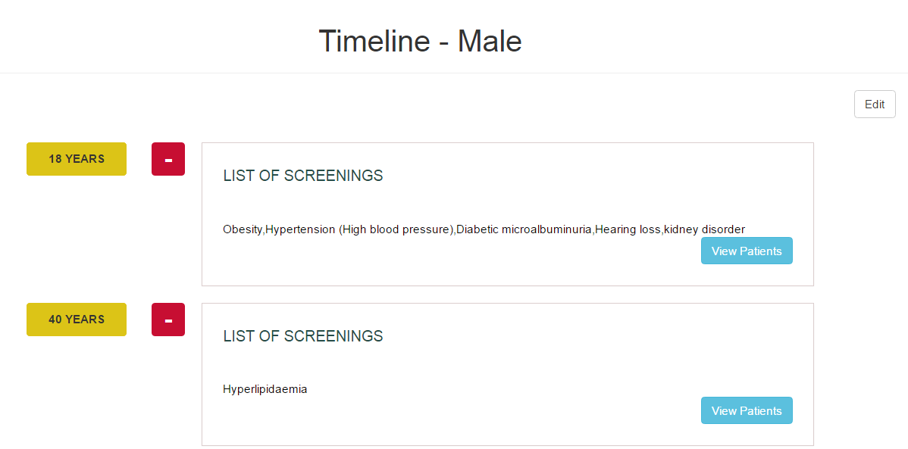
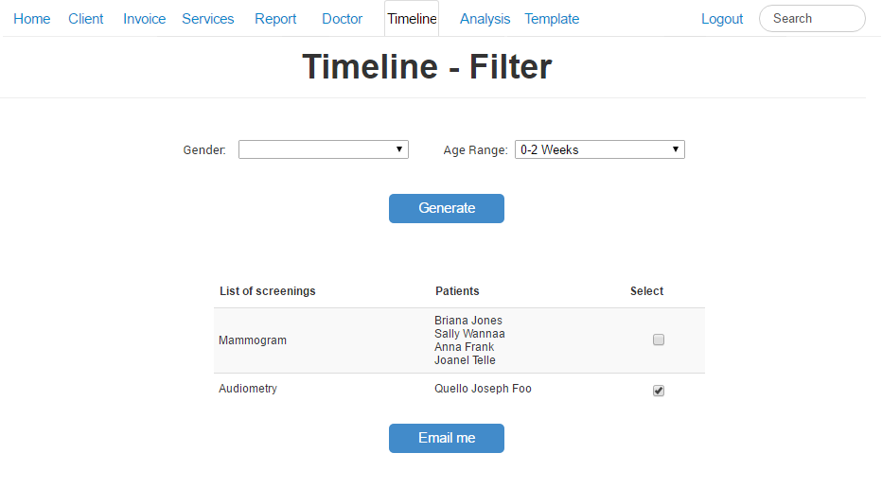

UT 1 Feedback
Timeline display is not intuitive, user suggested to change to table format
Stick to one color scheme
Client prefers to choose which patient to send email to instead of automated sending of email
Before
After
Introduction
Problem and Solution
Technologies
User Testing
Project Management
X-Factor
Reflections

Slide 27
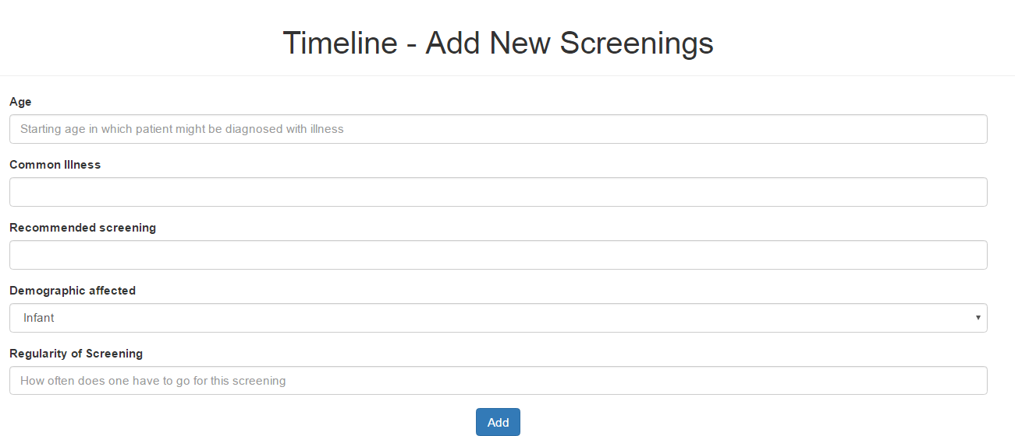
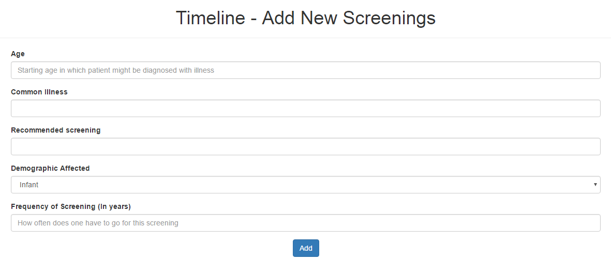
UT 1 Feedback
Rename Regularity field to Frequency of Screening (In Years) for easy understanding
Before
After
Introduction
Problem and Solution
Technologies
User Testing
Project Management
X-Factor
Reflections

Slide 28
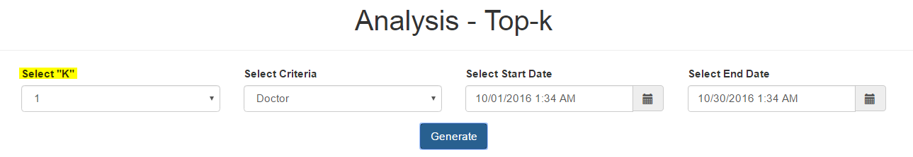

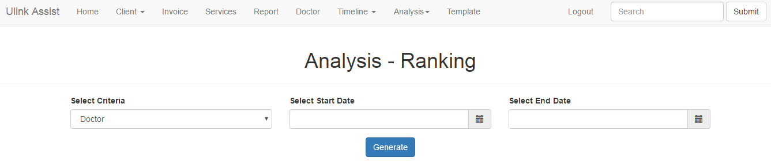
UT 1 Feedback
Top-K function to rename as "Ranking" for easy understanding
List all results in a ranked list instead of selecting “K” value
Before
After
Introduction
Problem and Solution
Technologies
User Testing
Project Management
X-Factor
Reflections

Slide 29
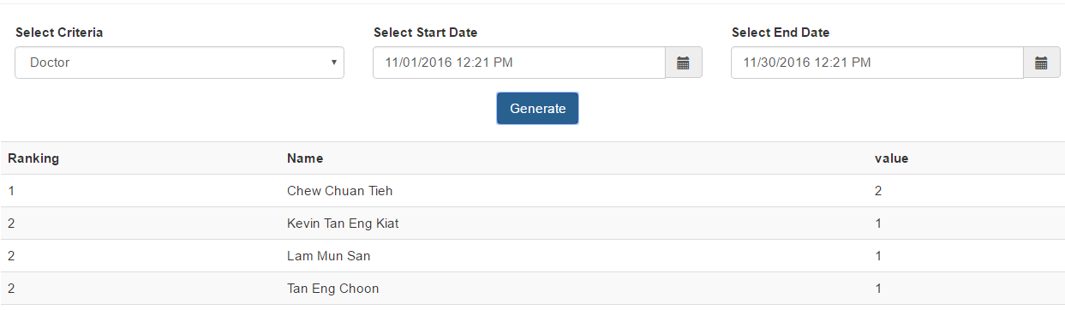
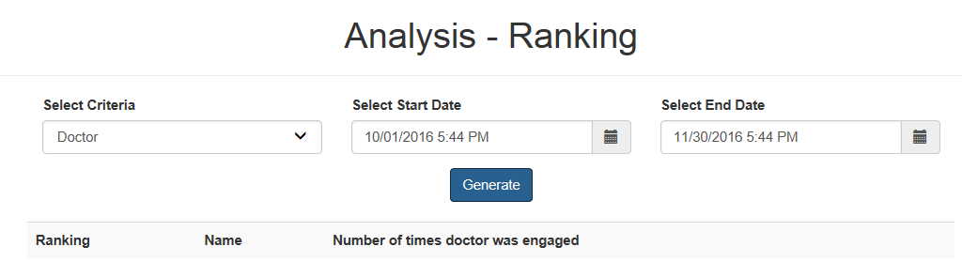
UT 1 Feedback
Confusing naming
Before
After
Introduction
Problem and Solution
Technologies
User Testing
Project Management
X-Factor
Reflections

Slide 30
User Testing 2
Usability & Heuristic Test
Purpose: Identify any usability problems & UI issues
Participant: 5 Ulink employees
(Management, Medical, Visa, Marketing, Accounts)
Date: 10 January 2017
Time: 3.30pm
Venue: Ulink Assist Pte Ltd
Scope:
Login/ Logout
Screenings
Client
Data Management
Introduction
Problem and Solution
Technologies
User Testing
Project Management
X-Factor
Reflections
Notes:
Client prefers to choose which patient to send email to instead of automated sending of email
Analysis results to be in numbers

Slide 31
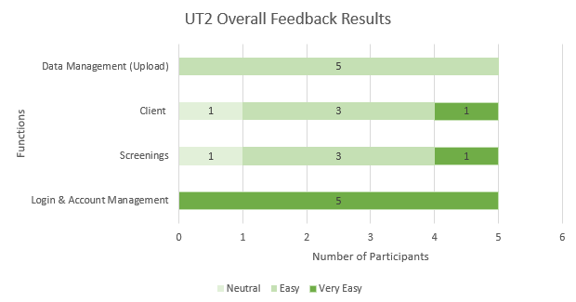
UT 2 Usability
Introduction
Problem and Solution
Technologies
User Testing
Project Management
X-Factor
Reflections
Notes:
Client prefers to choose which patient to send email to instead of automated sending of email
Analysis results to be in numbers

Slide 32
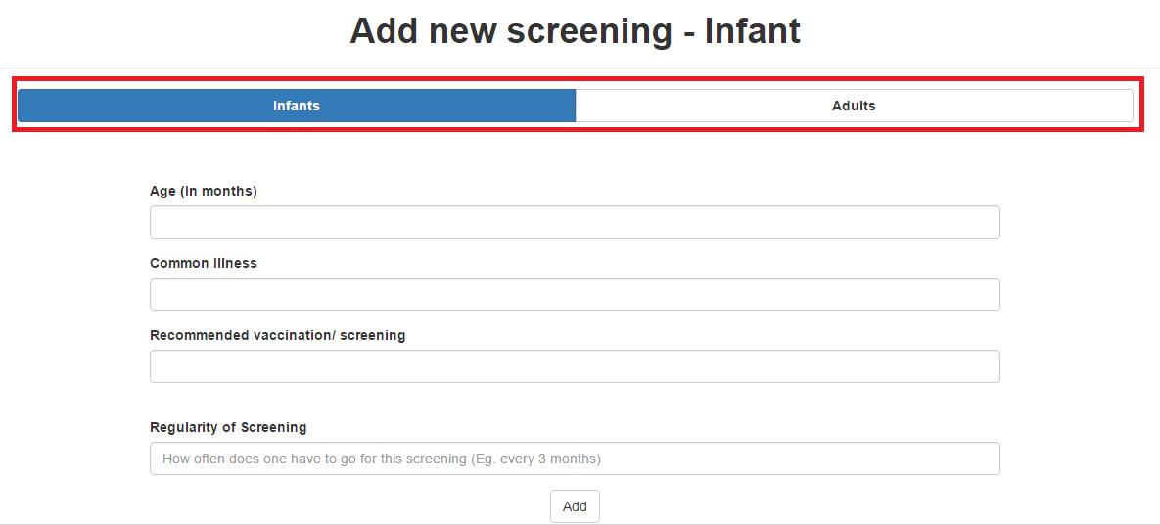
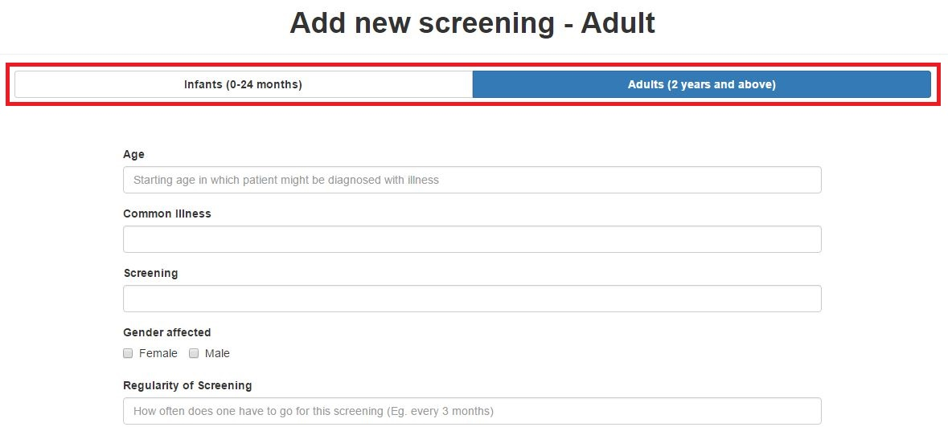
UT 2 Heuristics Improvements
Header of Screening form is not specific
Before
After
Introduction
Problem and Solution
Technologies
User Testing
Project Management
X-Factor
Reflections

Slide 33
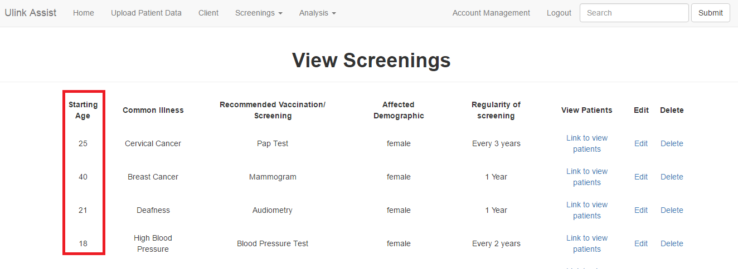
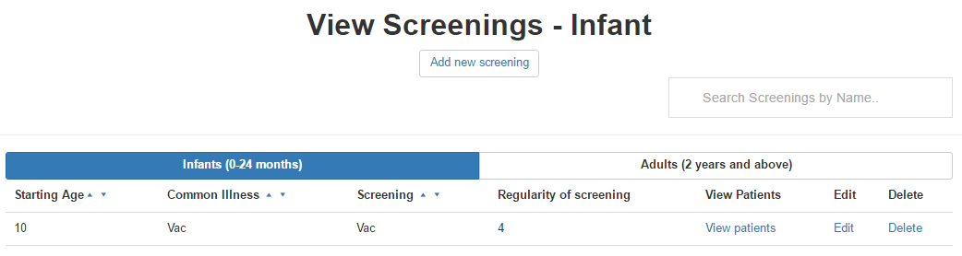
UT 2 Heuristics Improvements
Infants and Adults screenings should have different views
To prevent confusion in age (months, years)
Before
After
Introduction
Problem and Solution
Technologies
User Testing
Project Management
X-Factor
Reflections

Slide 34
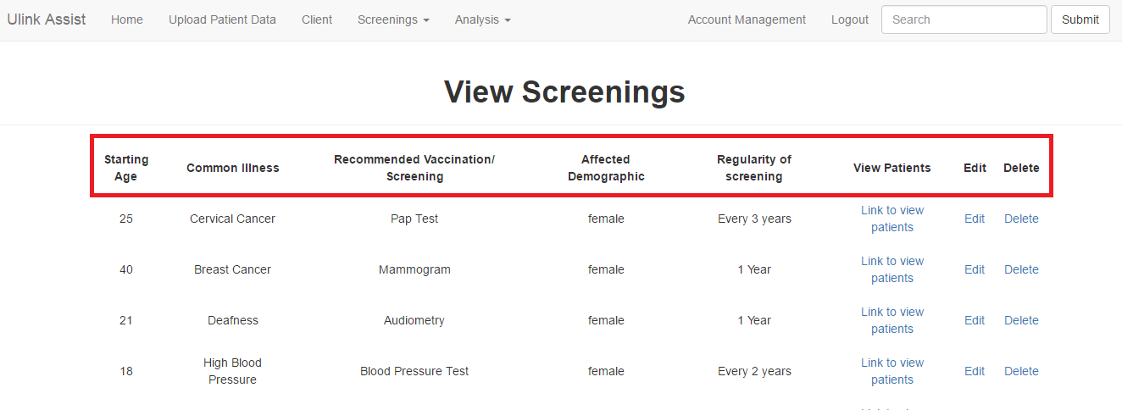
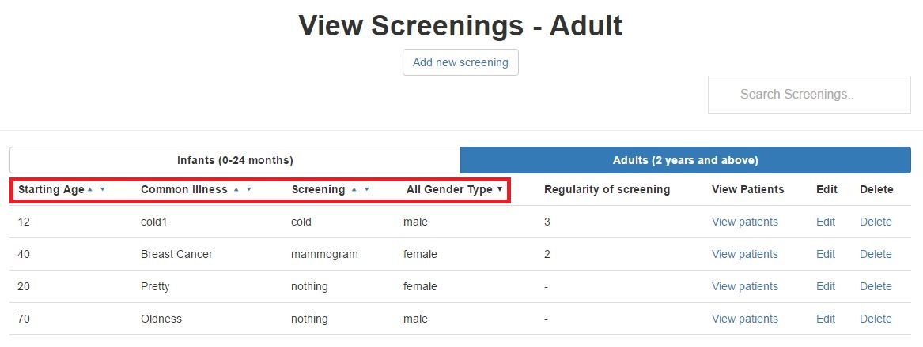
UT 2 Heuristics Improvements
Difficult to search for particular client/ screenings
Search & sort features allow easier search
Before
After
Introduction
Problem and Solution
Technologies
User Testing
Project Management
X-Factor
Reflections

Slide 35


User Testing 3
Purpose:
Gather UI feedback & detect usability issues
Measure time taken for each task
Participant: 6 Ulink employees
(Management, Medical, Visa, Marketing, Accounts)
Date: 13 February 2017
Time: 4.30pm
Venue: Ulink Assist Pte Ltd
Scope:
Data Management
Dashboard Module
Reports Module
KPI, Ranking, Gender-Age
Screenings
Email Notification
Text Editor
Dashboard & Reports
Visual graphs provides better understanding
User interface
Straightforward & user-friendly
Introduction
Problem and Solution
Technologies
User Testing
Project Management
X-Factor
Reflections

Slide 36
User Testing 3 Procedure
Login
Data Management
Reports -KPI
Reports - Ranking
Gender and Age
Screening
Dashboard
Email Recommended Screenings
Introduction
Problem and Solution
Technologies
User Testing
Project Management
X-Factor
Reflections

Slide 37
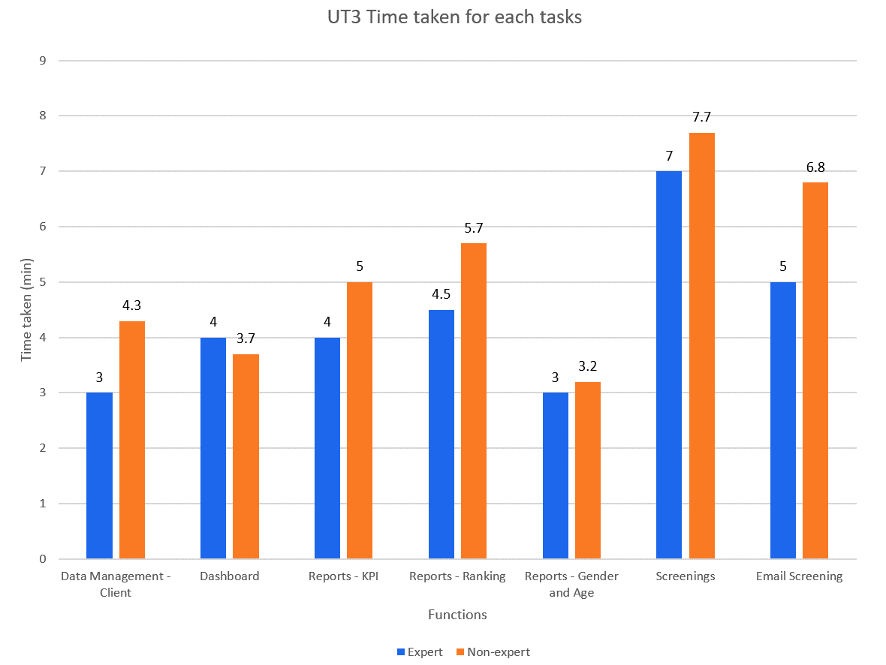
User Testing 3 Results
Non–experts should take not more than 150% of expert’s time taken
Introduction
Problem and Solution
Technologies
User Testing
Project Management
X-Factor
Reflections

Slide 38
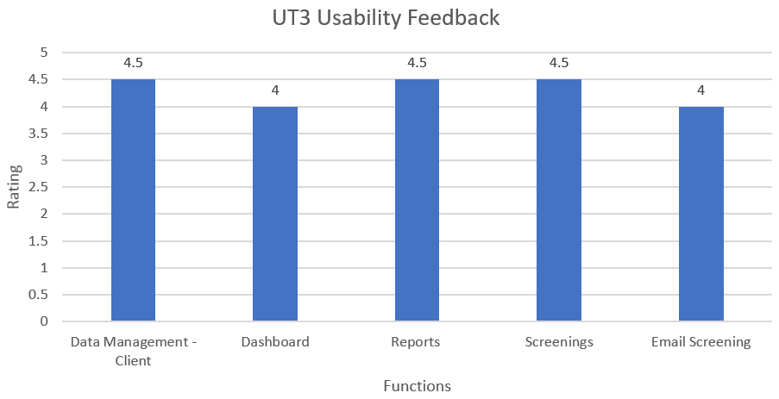
UT 3 Feedback
Very Easy
Very Difficult
Introduction
Problem and Solution
Technologies
User Testing
Project Management
X-Factor
Reflections

Slide 39
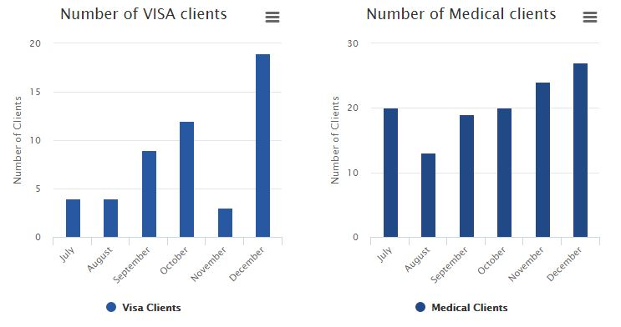
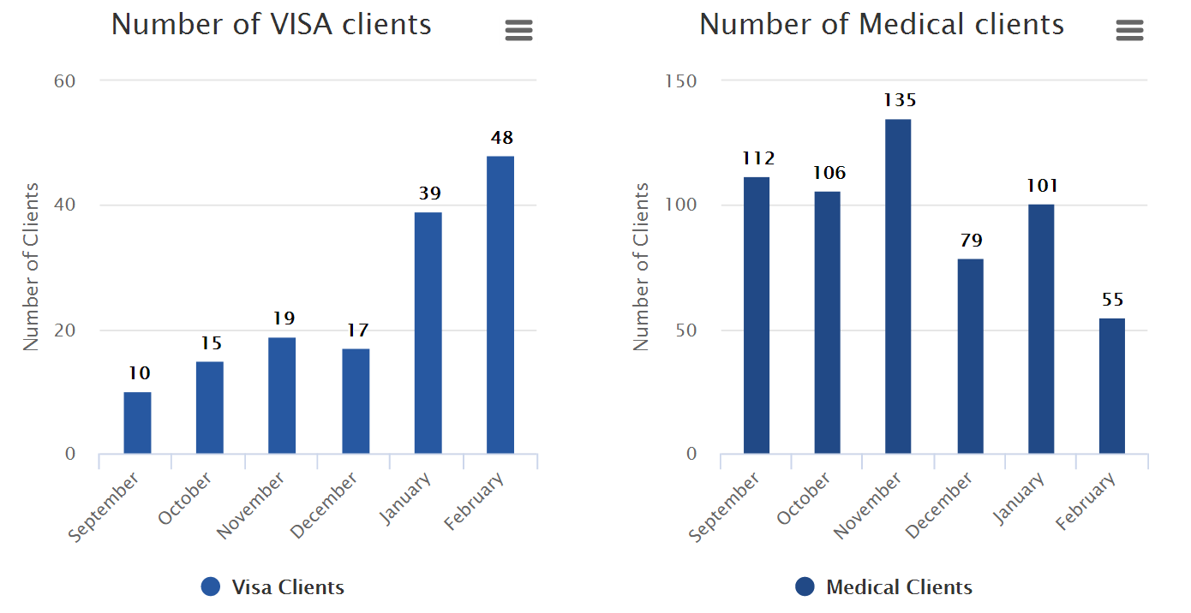
UT 3 Feedback
Data labels added
Before
After
Introduction
Problem and Solution
Technologies
User Testing
Project Management
X-Factor
Reflections

Slide 40
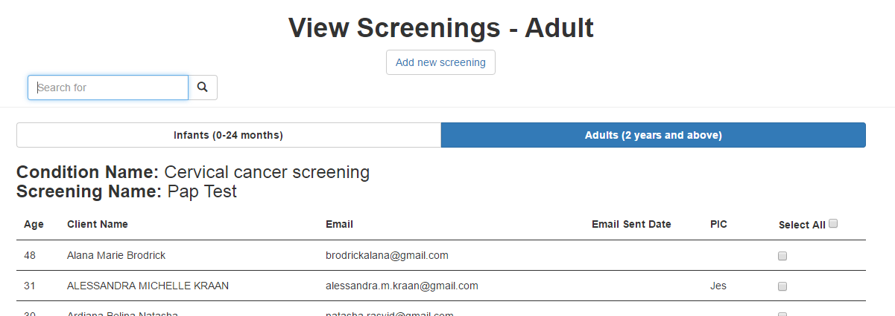
UT 3 Feedback
Select All Button
‘PIC’ column
‘Email Sent’ column (Last sent date)
Introduction
Problem and Solution
Technologies
User Testing
Project Management
X-Factor
Reflections

Slide 41
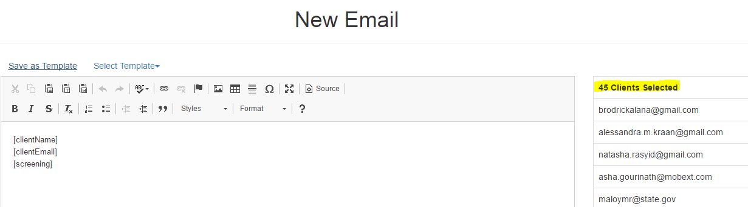
UT 3 Feedback
Number of clients selected
Before
Introduction
Problem and Solution
Technologies
User Testing
Project Management
X-Factor
Reflections

Slide 42
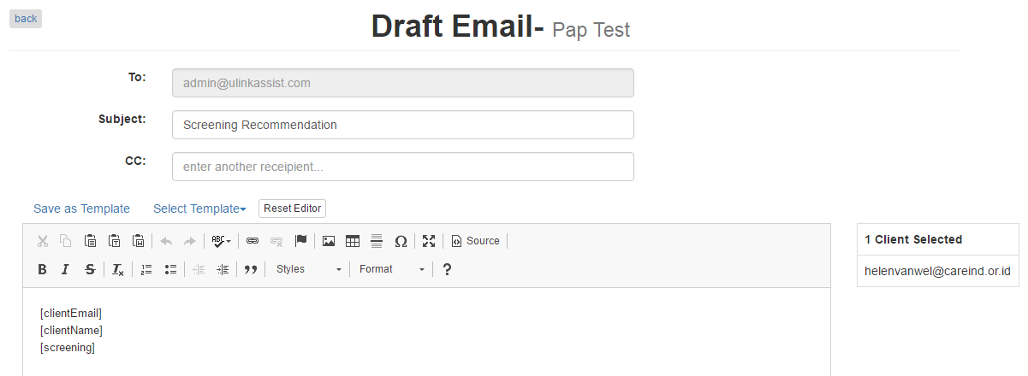
UT 3 Feedback
Improvements made
Specify recipients
Introduction
Problem and Solution
Technologies
User Testing
Project Management
X-Factor
Reflections

Slide 43
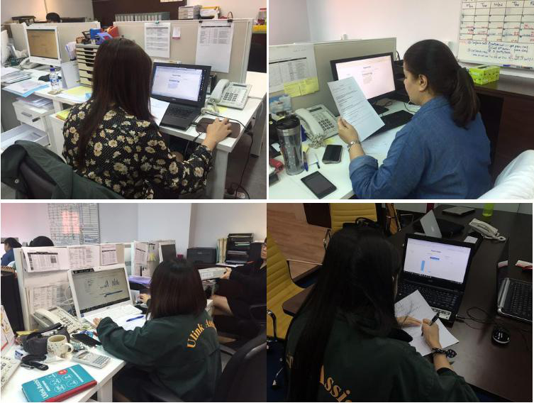
User Testing 4
Purpose:
Gather UI feedback and detect usability issues
Participant: 8 Ulink employees
Date: 21 March 2017
Time: 4.00pm
Scope:
Index
Client
Email Recommendation
Export
Introduction
Problem and Solution
Technologies
User Testing
Project Management
X-Factor
Reflections

Slide 44


UT 4 Feedback
Email templates save time
Unsure of where to click for certain functions
Exported graphs should have data labels
Not very sure of Index (Point of Contact) function
Drop down calendar not intuitive
Client Page is very long/ takes very long to load
Introduction
Problem and Solution
Technologies
User Testing
Project Management
X-Factor
Reflections
Notes:
Client prefers to choose which patient to send email to instead of automated sending of email
Analysis results to be in numbers

Slide 45
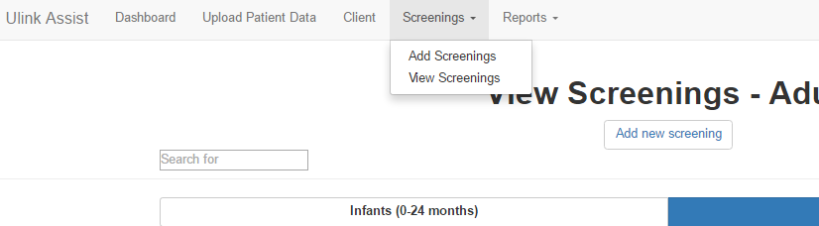
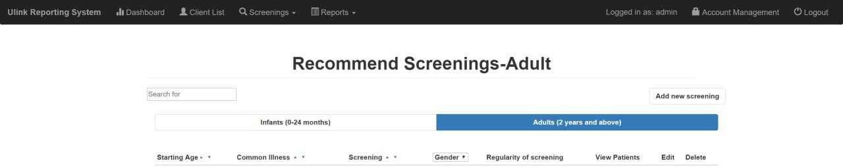
UT 4 Heuristics Improvements
Before
Unsure of where to click for certain functions
After
Introduction
Problem and Solution
Technologies
User Testing
Project Management
X-Factor
Reflections

Slide 46
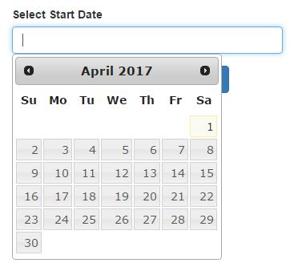
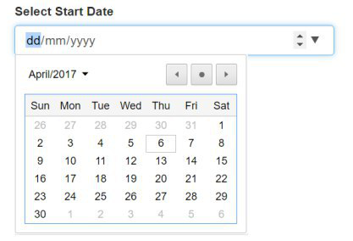
UT 4 Heuristics Improvements
Before
Drop down calendar not intuitive
After
Introduction
Problem and Solution
Technologies
User Testing
Project Management
X-Factor
Reflections

Slide 47
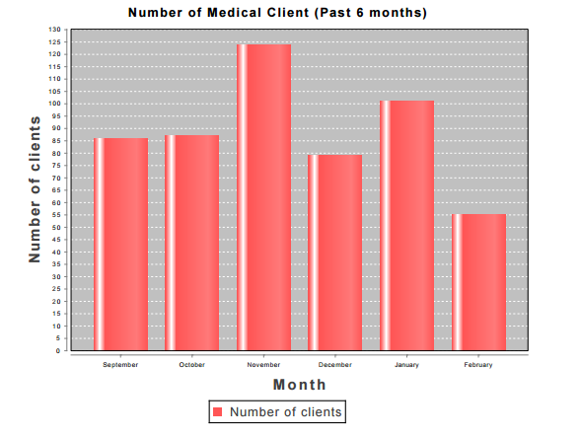
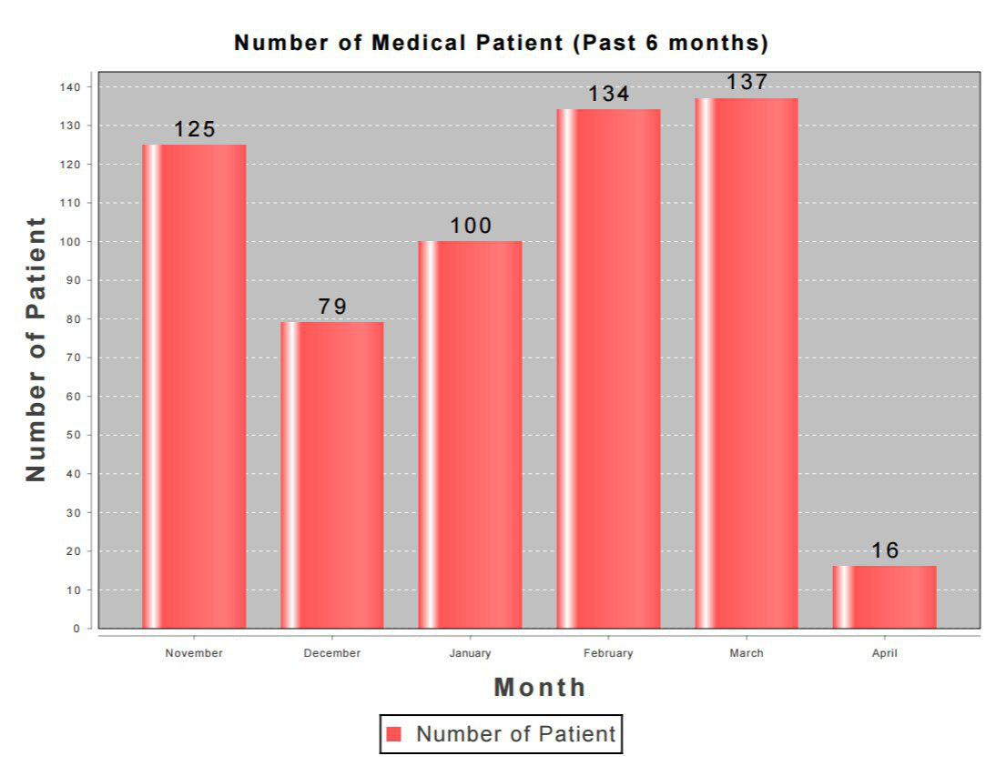
UT 4 Heuristics Improvements
Exported graphs should have data labels
Before
After
Introduction
Problem and Solution
Technologies
User Testing
Project Management
X-Factor
Reflections

Slide 48
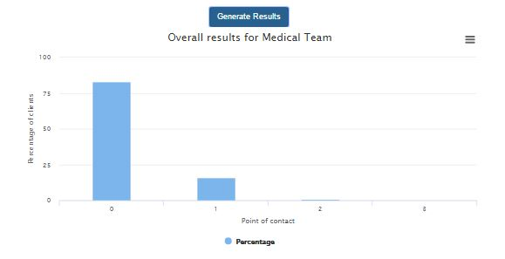
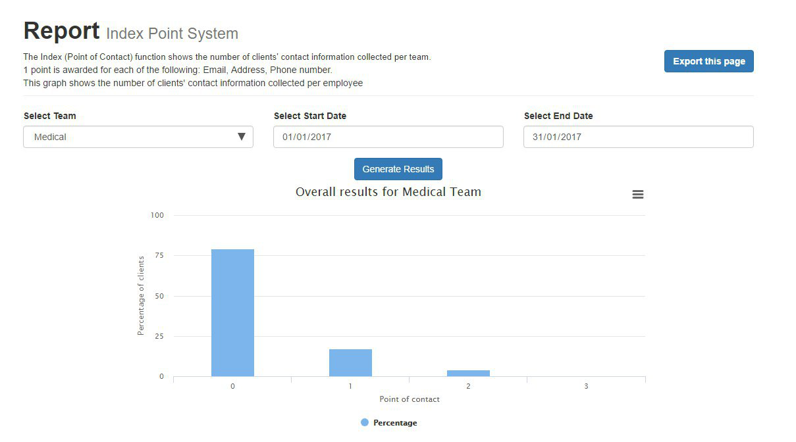
UT 4 Heuristics Improvements
Not very sure of Index (Point of Contact) function
Before
After
Introduction
Problem and Solution
Technologies
User Testing
Project Management
X-Factor
Reflections

Slide 49
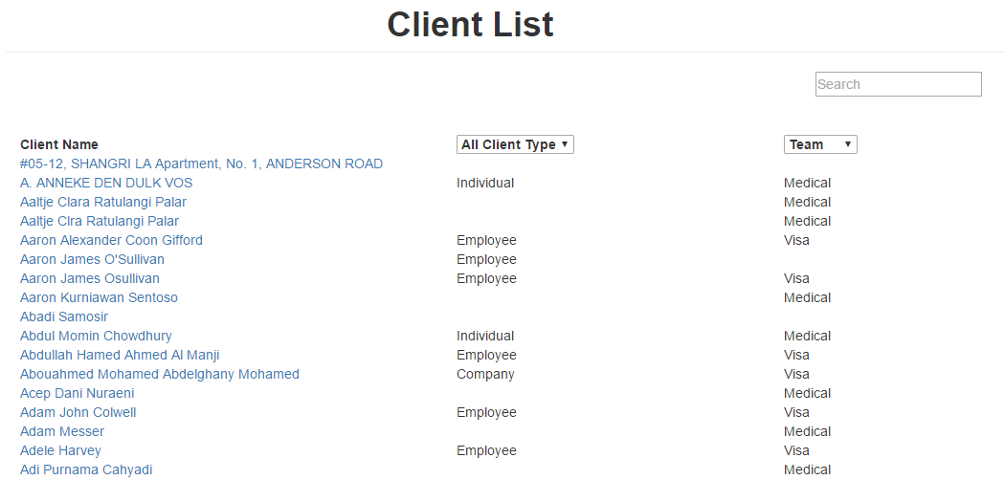
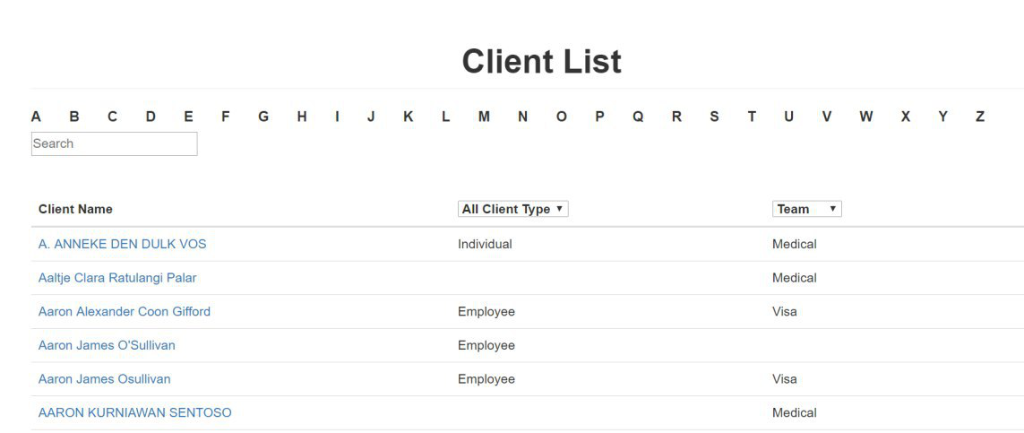
UT 4 Heuristics Improvements
Client Page is very long/ take a long time to load
Before
After
Introduction
Problem and Solution
Technologies
User Testing
Project Management
X-Factor
Reflections

Slide 50
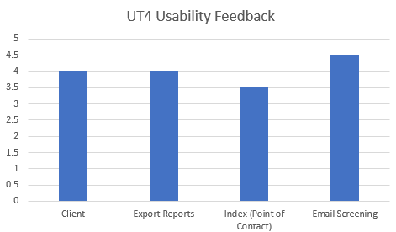
UT 4 Feedback
Very Easy
4.5
4
4
3.5
Very Difficult
Introduction
Problem and Solution
Technologies
User Testing
Project Management
X-Factor
Reflections

Slide 51
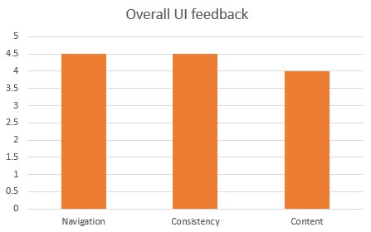
UT 4 Feedback
Good
4.5
4.5
4.0
Poor
Introduction
Problem and Solution
Technologies
User Testing
Project Management
X-Factor
Reflections

Slide 52

UT Takeaways
Gather perspective & opinions of different users
Continuously work on improving the functions
Introduction
Problem and Solution
Technologies
User Testing
Project Management
X-Factor
Reflections

Slide 53
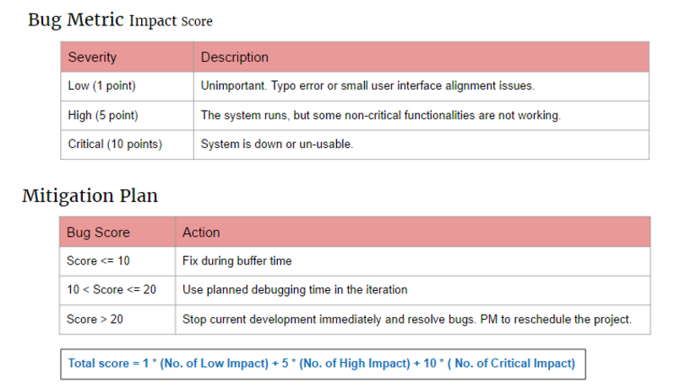
Bug Metric
Introduction
Problem and Solution
Technologies
User Testing
Project Management
X-Factor
Reflections

Slide 54
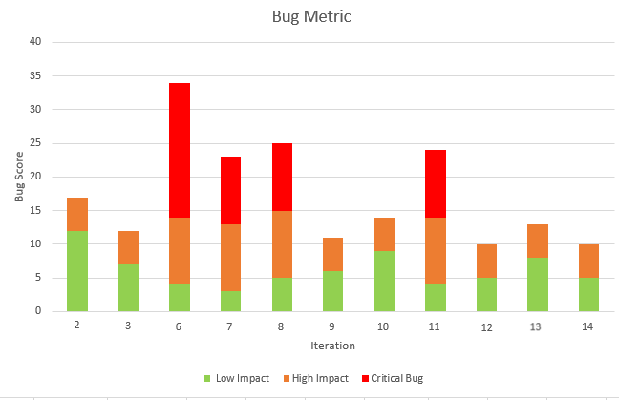
Bug Metric
2
1
1
1
1
2
2
1
2
12
1
2
1
1
1
9
1
7
8
4
5
6
4
5
5
3
Introduction
Problem and Solution
Technologies
User Testing
Project Management
X-Factor
Reflections

Slide 55

Project Management

Slide 56
Project Progress
14 Iterations
4 User Testing
100% Completed
Introduction
Problem and Solution
Technologies
User Testing
Project Management
X-Factor
Reflections
Notes:
10/34

Slide 57
Project Handover
13 April 2017
Source code Database with current data
Documentations
Introduction
Problem and Solution
Technologies
User Testing
Project Management
X-Factor
Reflections
Notes:
10/34

Slide 58
Stakeholder Management
Supervisor: Professor Steven Hoi
Bi-weekly meetings
Update project progress
Past Iteration & upcoming iteration
Obtain feedback on project
Gather suggestions
Introduction
Problem and Solution
Technologies
User Testing
Project Management
X-Factor
Reflections
Notes:
2 – before acceptance, underestimate hours required for preparation
3 – schedule hours for bug fixing
6 – CRUD screenings not as easy as we thought
8 – Data management too much time - Iter 7 Ranking was shifted to iter 8. hence iter 8 has ranking and kpi functions to complete
9 – Over estimated time required for dashboard + gender and age report (more of charts and display)

Slide 59

Stakeholder Management
Team
Weekly meetings
Changes in scope & timeline
Integration, testing & debugging sessions
Introduction
Problem and Solution
Technologies
User Testing
Project Management
X-Factor
Reflections
Notes:
2 – before acceptance, underestimate hours required for preparation
3 – schedule hours for bug fixing
6 – CRUD screenings not as easy as we thought
8 – Data management too much time - Iter 7 Ranking was shifted to iter 8. hence iter 8 has ranking and kpi functions to complete
9 – Over estimated time required for dashboard + gender and age report (more of charts and display)

Slide 60
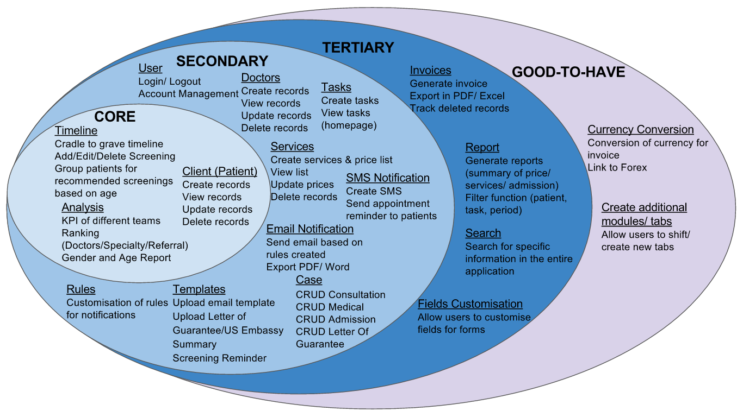

Acceptance Scope
Introduction
Problem and Solution
Technologies
User Testing
Project Management
X-Factor
Reflections
Notes:
10/34

Slide 61
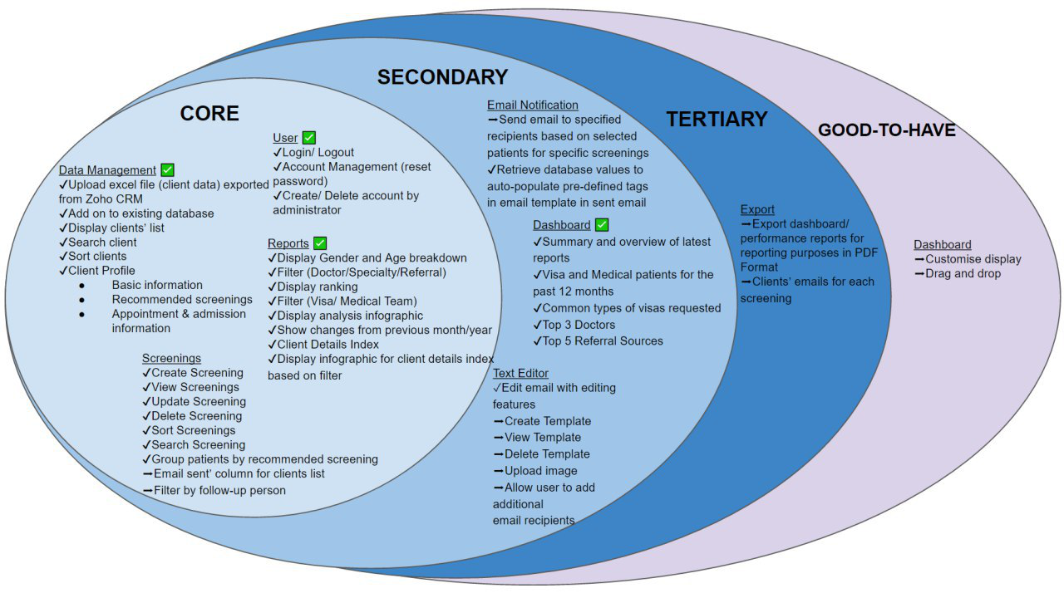
Mid-term Scope
Introduction
Problem and Solution
Technologies
User Testing
Project Management
X-Factor
Reflections
Notes:
10/34

Slide 62
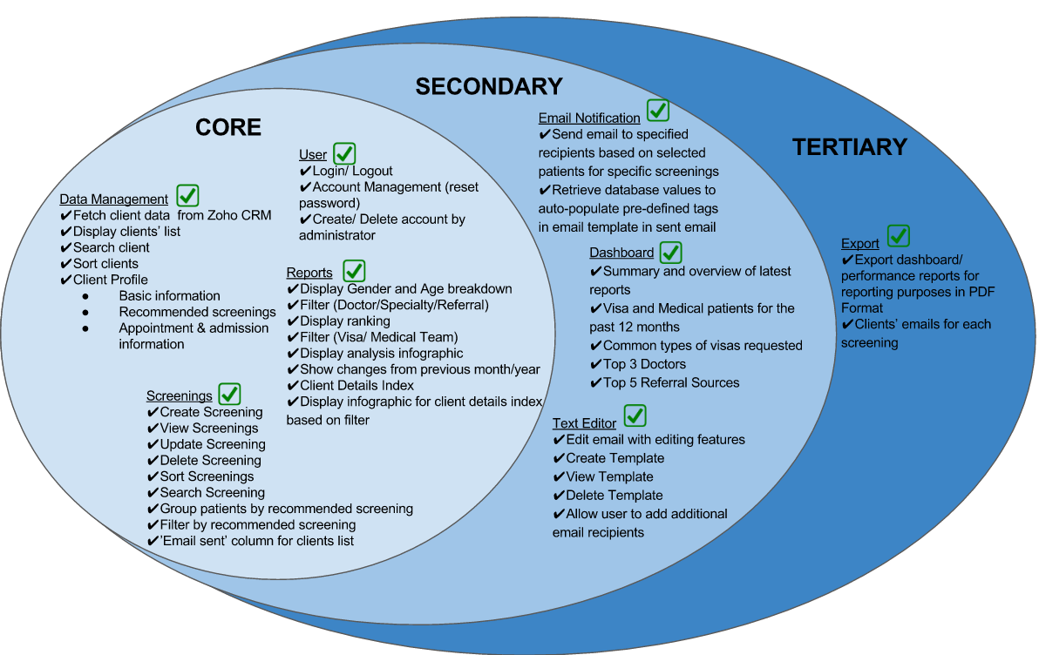
Final Scope
100%
Completed
Introduction
Problem and Solution
Technologies
User Testing
Project Management
X-Factor
Reflections

Slide 63

Planned Schedule
Introduction
Problem and Solution
Technologies
User Testing
Project Management
X-Factor
Reflections

Slide 64

Midterm Schedule
Introduction
Problem and Solution
Technologies
User Testing
Project Management
X-Factor
Reflections

Slide 65

Final Schedule
Introduction
Problem and Solution
Technologies
User Testing
Project Management
X-Factor
Reflections

Slide 66
Change Management

Slide 67


Process
Introduction
Problem and Solution
Technologies
User Testing
Project Management
X-Factor
Reflections

Slide 68
Changes
Added/Modified | Removed
Report – POC Index | Doctors
Database – take in additional fields from excel file | Tasks
CRUD Templates feature | Services
Screenings – follow up person | SMS Notification
Screenings – email sent column | Rules
Text editor allows selection of recipients | Invoices
Text editor allows upload of images | Currency Conversion
Export client emails in excel | Creating additional tabs/ modules
Introduction
Problem and Solution
Technologies
User Testing
Project Management
X-Factor
Reflections

Slide 69

Change Log
Introduction
Problem and Solution
Technologies
User Testing
Project Management
X-Factor
Reflections

Slide 70

Change Log
Introduction
Problem and Solution
Technologies
User Testing
Project Management
X-Factor
Reflections

Slide 71

Change Log
Introduction
Problem and Solution
Technologies
User Testing
Project Management
X-Factor
Reflections

Slide 72

Task Metric
Screenings – unable to edit
Delete button removes data for both genders
Preparation for midterms
Bug fixing after midterms
Reports – Incorrect values generated
UI – Date picker, Filters
Introduction
Problem and Solution
Technologies
User Testing
Project Management
X-Factor
Reflections
Notes:
Shifted uploading data to next Iteration
Shifted Gender - Age report to next Iteration
Shifted Export report to next Iteration

Slide 73

Effort Metric
Under-estimated hours for acceptance
Midterms Presentation
Bug fixing after midterms
More hours required for bug fixing
Introduction
Problem and Solution
Technologies
User Testing
Project Management
X-Factor
Reflections
Notes:
2 – before acceptance, underestimate hours required for preparation
6 – CRUD screenings not as easy as we thought
8 – Iter 7 Ranking was shifted to iter 8. hence iter 8 has ranking and kpi functions to complete
9 – Over estimated time required for dashboard + gender and age report (more of charts and display)

Slide 74


Risk Management
Technical Risk
Unfamiliar with coding language
E,g. Javascript, JQuery
More experienced developer to share knowledge
Developers to research & learn technologies
Assistant developer to help with complex tasks
Introduction
Problem and Solution
Technologies
User Testing
Project Management
X-Factor
Reflections

Slide 75
Risk Management
Project Management Risk
Allocation of too much/ little time for development of functions
Buffer days before submission
Allocate more time for more complex tasks
Introduction
Problem and Solution
Technologies
User Testing
Project Management
X-Factor
Reflections

Slide 76
Risk Management
Client Risk
Change in client’s requirement
Meet & update client bi-weekly
Ensure that development is on par with client’s requirements
Present client prototype before development
Introduction
Problem and Solution
Technologies
User Testing
Project Management
X-Factor
Reflections

Slide 77
X-FACTOR
Midterm
At least 50% of clients’ responses (via email, phone calls)
Introduction
Problem and Solution
Technologies
User Testing
Project Management
X-Factor
Reflections
Notes:
Current % of repeat clients: 14.3036%
Finals, make some improvements to emails sent out (mkting)

Slide 78

X-FACTOR
Introduction
Problem and Solution
Technologies
User Testing
Project Management
X-Factor
Reflections
Notes:
Current % of repeat clients: 14.3036%
Finals, make some improvements to emails sent out (mkting)

Slide 79

X-FACTOR
Introduction
Problem and Solution
Technologies
User Testing
Project Management
X-Factor
Reflections
Notes:
Current % of repeat clients: 14.3036%
Finals, make some improvements to emails sent out (mkting)

Slide 80

X-FACTOR
Introduction
Problem and Solution
Technologies
User Testing
Project Management
X-Factor
Reflections
Notes:
Current % of repeat clients: 14.3036%
Finals, make some improvements to emails sent out (mkting)

Slide 81
X-FACTOR
Final
Ulink Reporting System fetches live data from Zoho CRM
50% more targeted clients’ responses compared to non-targeted clients’
Introduction
Problem and Solution
Technologies
User Testing
Project Management
X-Factor
Reflections
Notes:
Current: Once a month 1 out of 20 days > 5%
Target: Weekly 4 out of 20 days > 20%
Current % of repeat clients: 14.3036%
Finals, make some improvements to emails sent out (mkting)

Slide 82
Clients’ Feedback
Feedback on the team:
Responsive and efficient
Easy to work with
Feedback on the system:
Value-added functions for our team to track performance
Strengthen follow-up with our patients
Increase client engagements

Slide 83
Future Plans
Feedback on the team:
Responsive and efficient
Easy to work with
Feedback on the system:
Value-added functions for our team to track performance
Strengthen follow-up with our patients
Increase client engagements

Slide 84





Reflections
Shu yan
I have learnt the importance gathering users’ feedback through user testing so that we can continue improving our system to suit our clients’ needs.
nicole
I have learnt to explore different designs of our user interface. Through this project, I have gain more knowledge on front end development.
Sean
I have learnt the importance of communicating with my team mates in order to ensure that everyone is working towards the right direction.
Kaixin
Nabilah BANU
I have learnt the importance of managing clients’ expectations and understanding the strengths of my team.
I have learnt to be more receptive to feedback given by our clients. On top of that, I learned to be more attentive to details when designing the UI.
Introduction
Problem and Solution
Technologies
User Testing
Project Management
X-Factor
Reflections

Slide 85

Thank you

Slide 86
Problem
Unable to keep track of teams’ performances
No platform for Ulink to recommend screenings to client
Views are not optimised
Difficult to determine engagements with stakeholders
Unable to customize reports with required fields
No consolidated overview of required reports
Introduction
Problem and Solution
Technologies
Project Management
User Testing
X-Factor
Reflections
Notes:
currently customers come to find ulink for screenings and there is no platform for ulink to push screenings to customers.

Slide 87
Market Research
Recommended screening based on demographic
Dashboard Reporting (Key performance metrics)
Monitor Departments’ Performance
Ranking (Stakeholder engagements)
Client Profile (Consolidated profile view of each client)
Introduction
Problem and Solution
Technologies
Project Management
User Testing
X-Factor
Reflections

Slide 88
User Testing 3 Procedure
Login
Data Management (Client)
Reports -KPI
Reports - Ranking
Gender and Age
Screening
Dashboard
Email Recommended Screenings
Introduction
Problem and Solution
Technologies
Project Management
User Testing
X-Factor
Reflections

